Slide 1


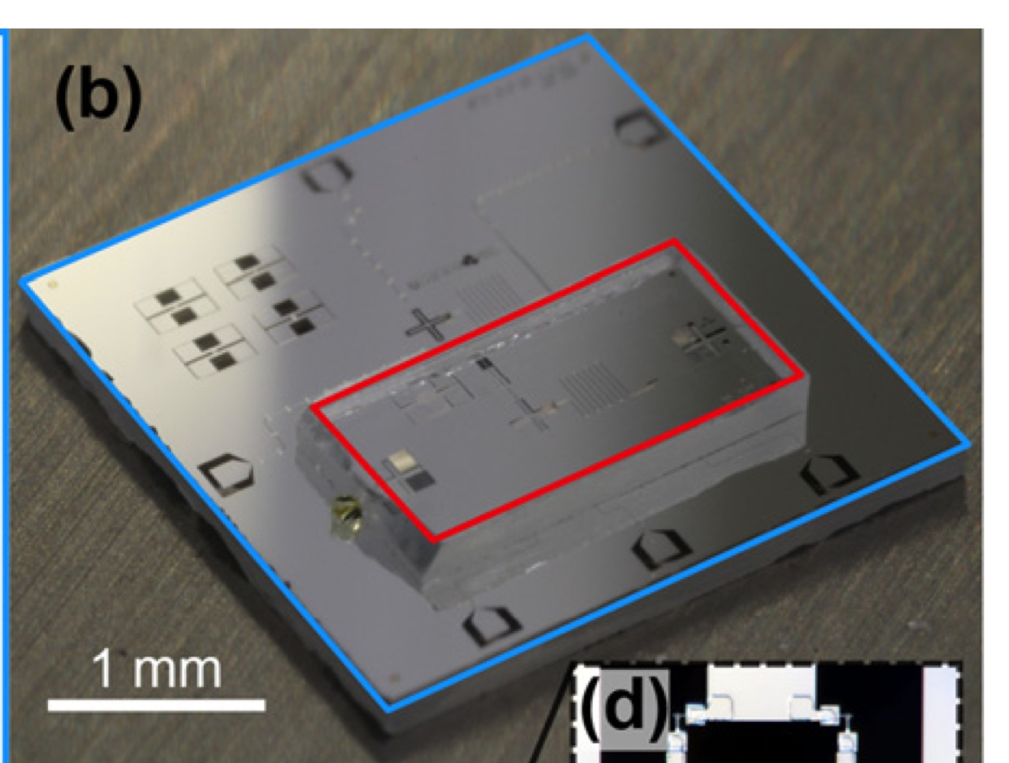
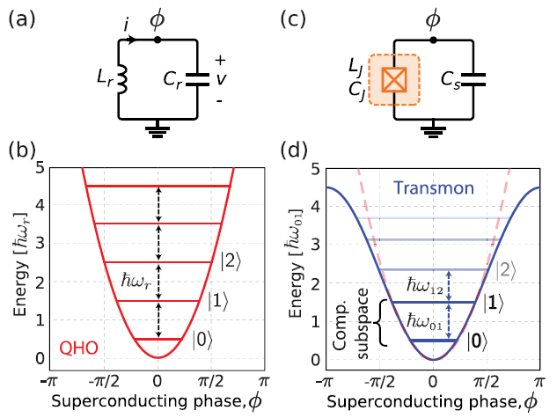
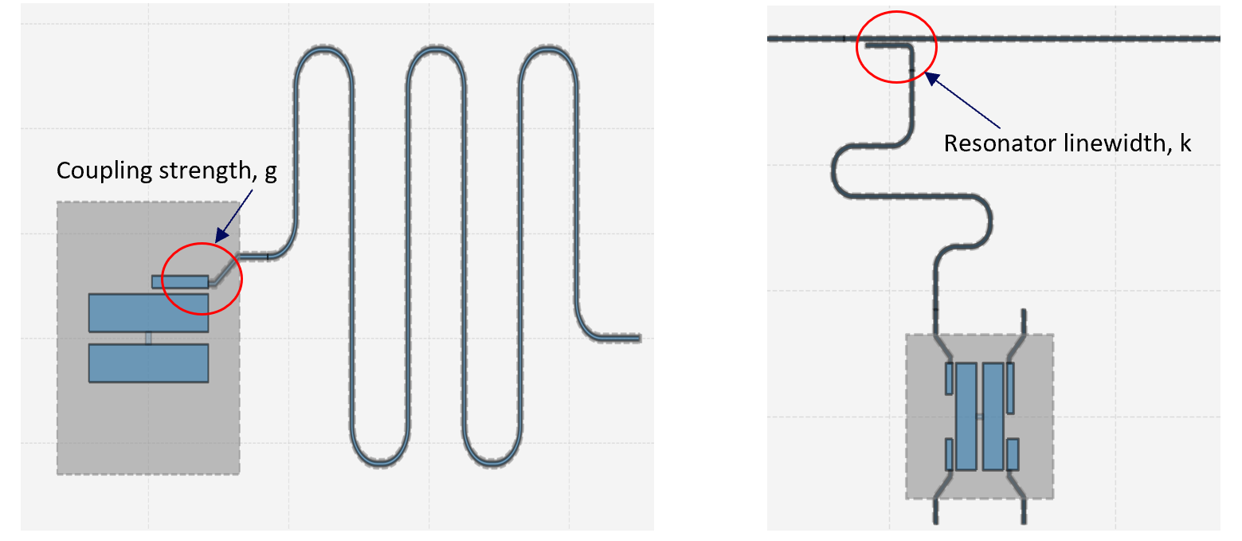
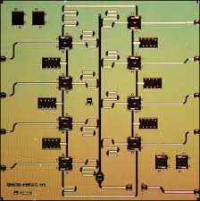
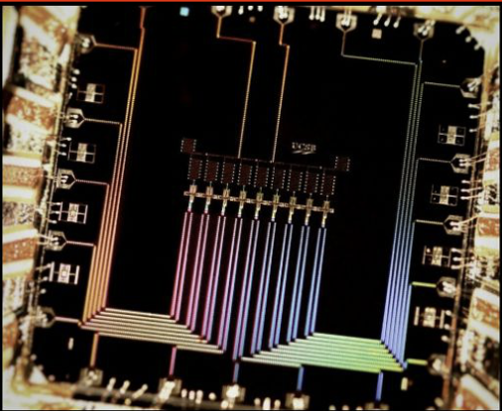
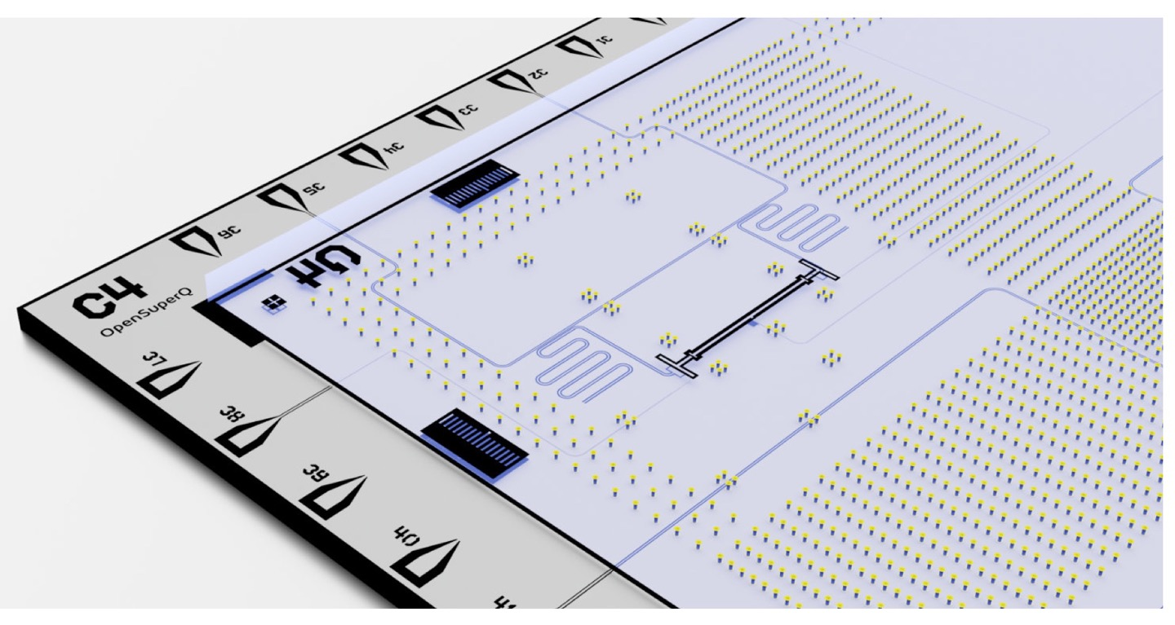
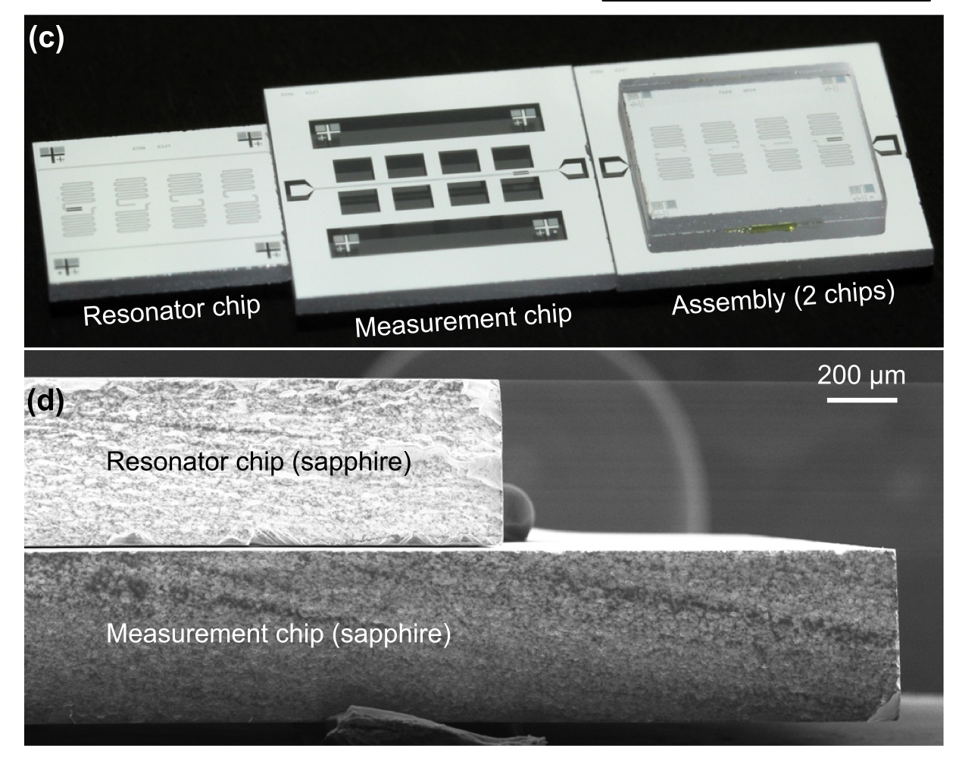
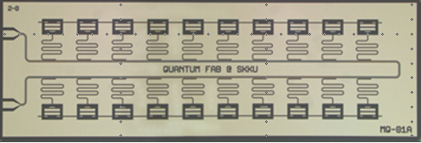
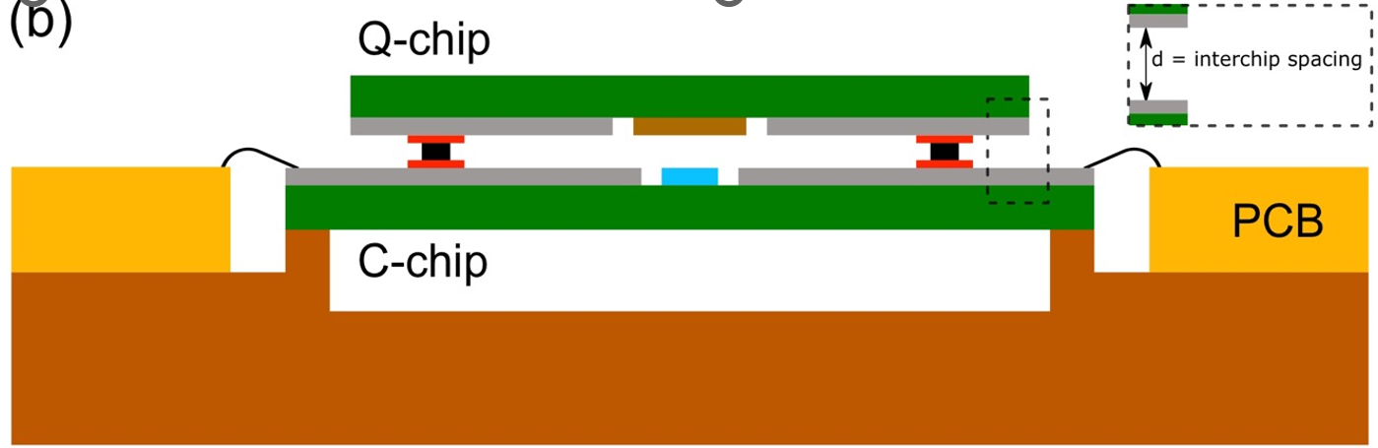
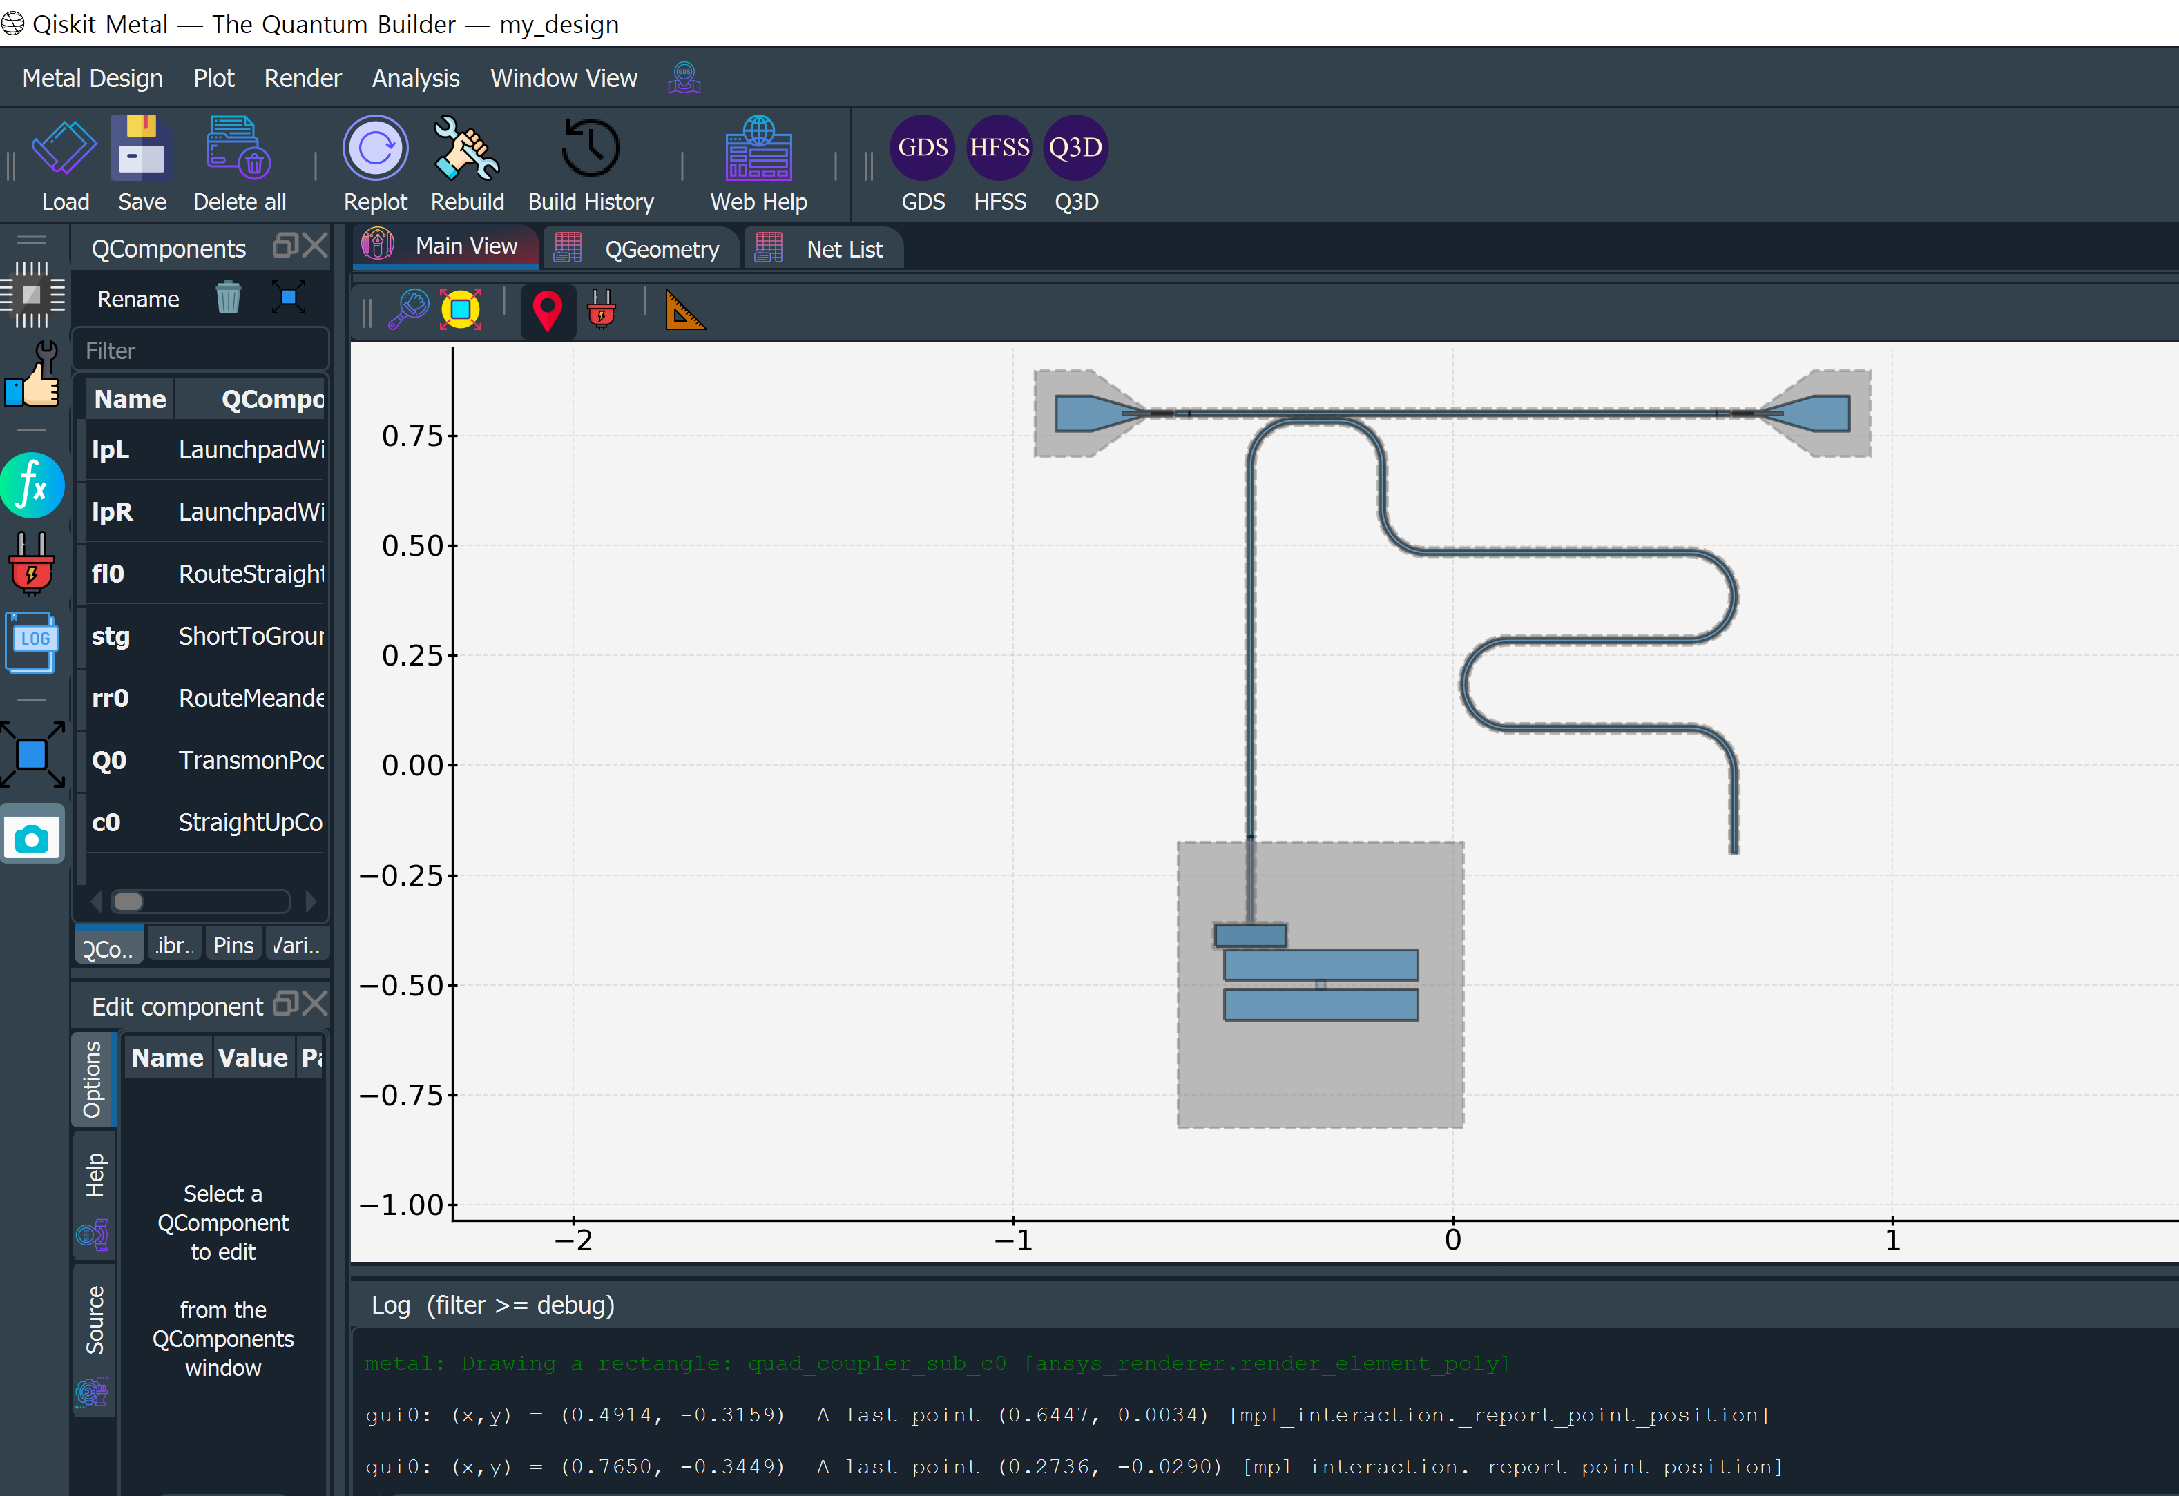
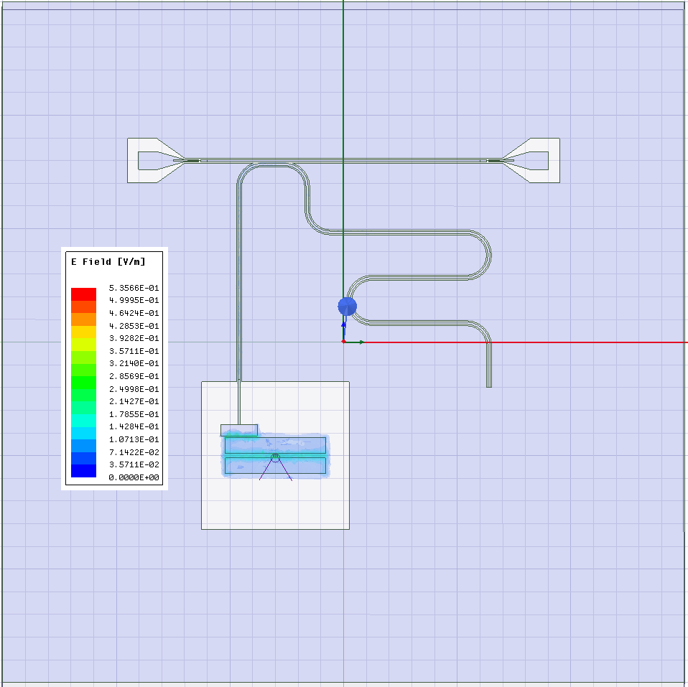
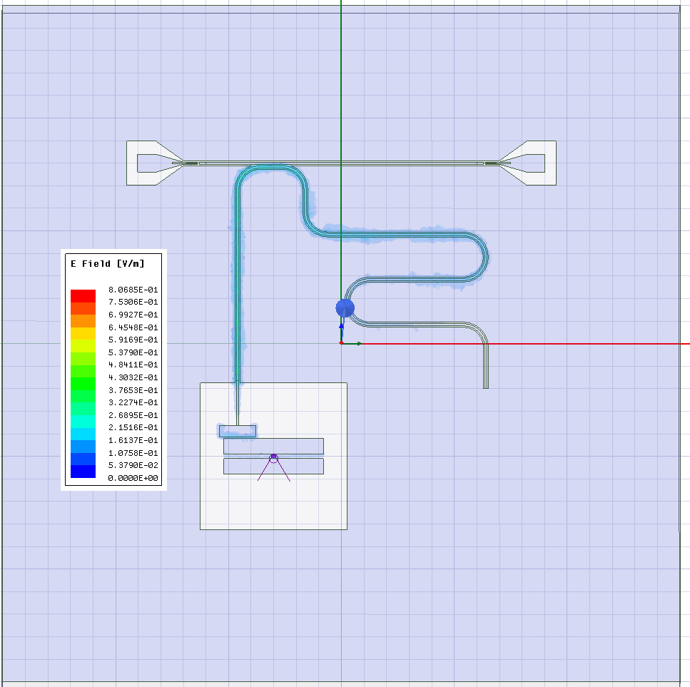
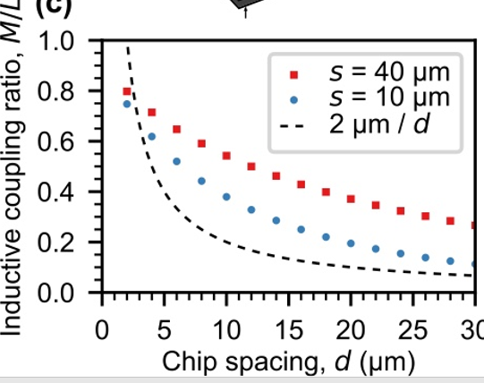
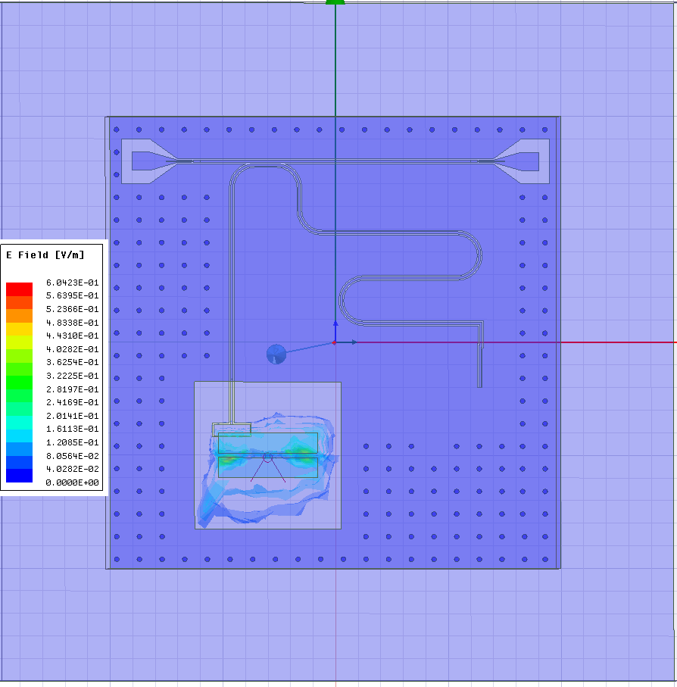
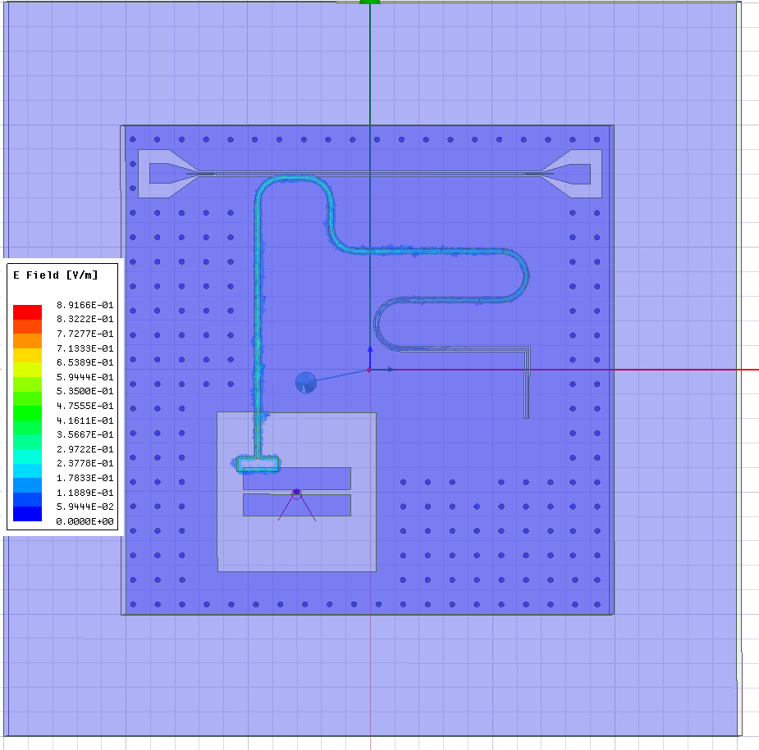
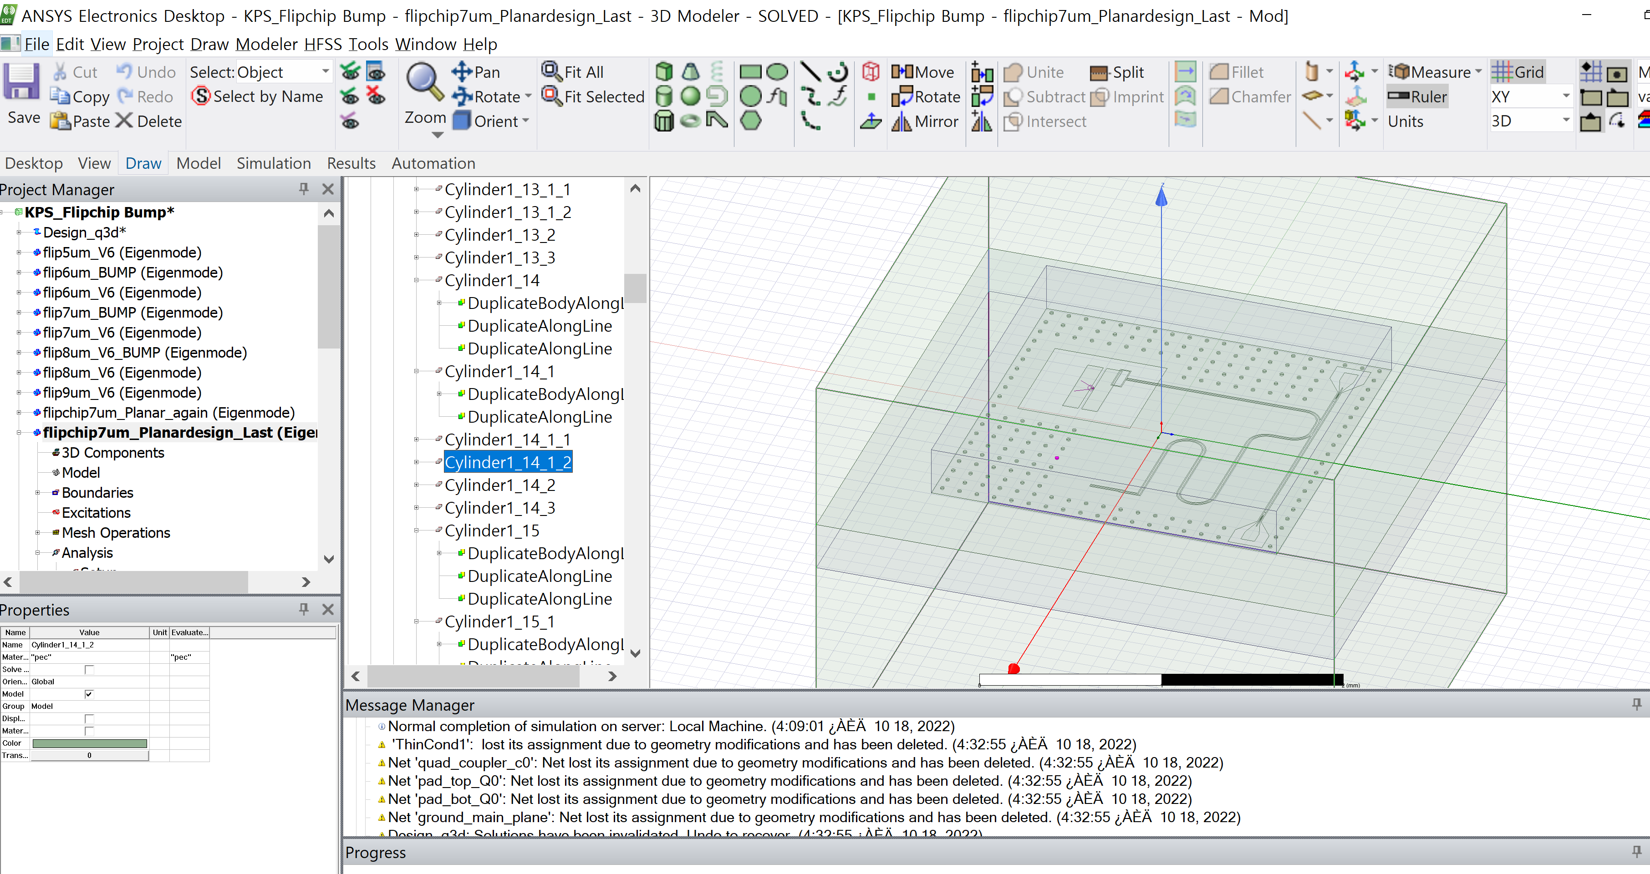
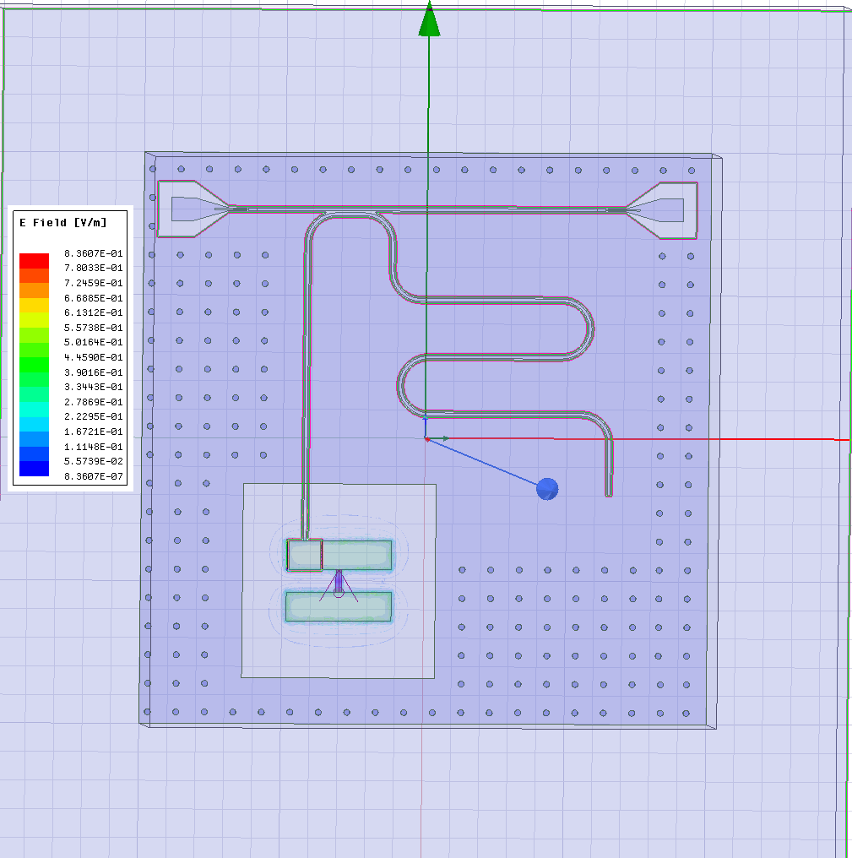
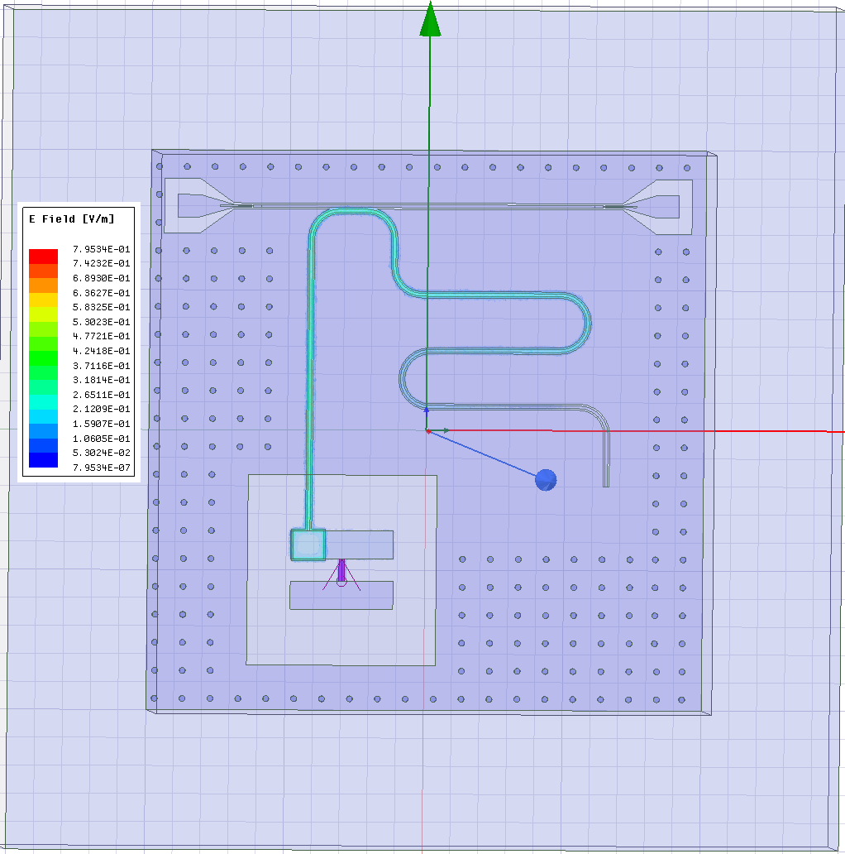
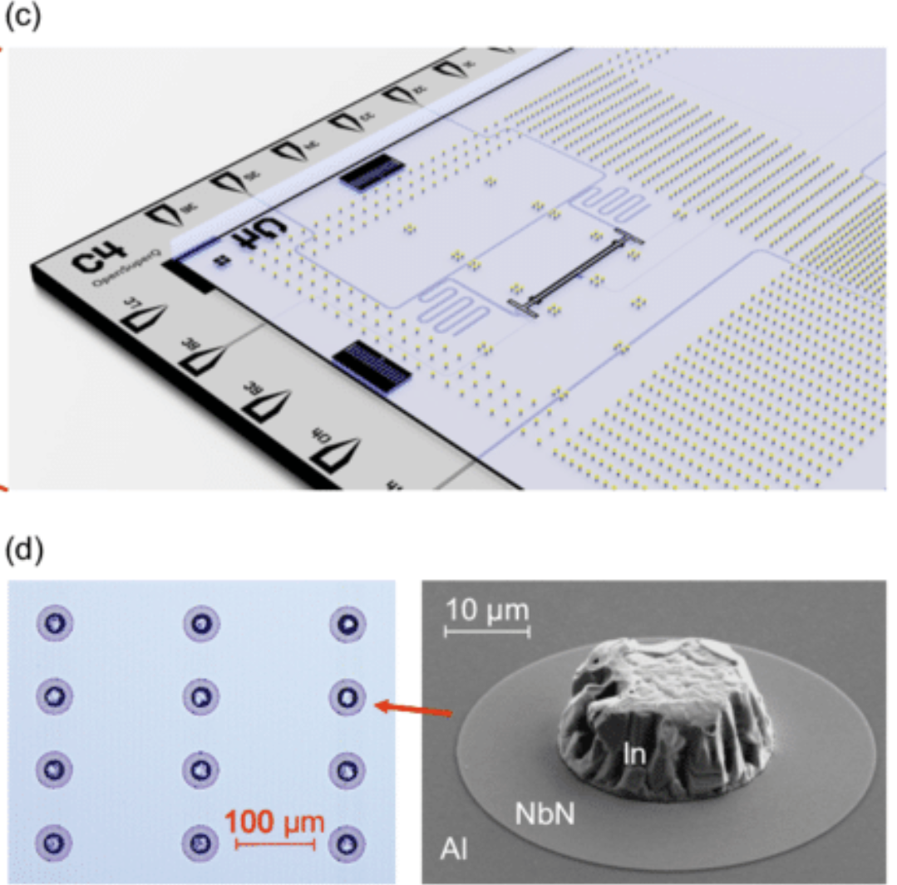
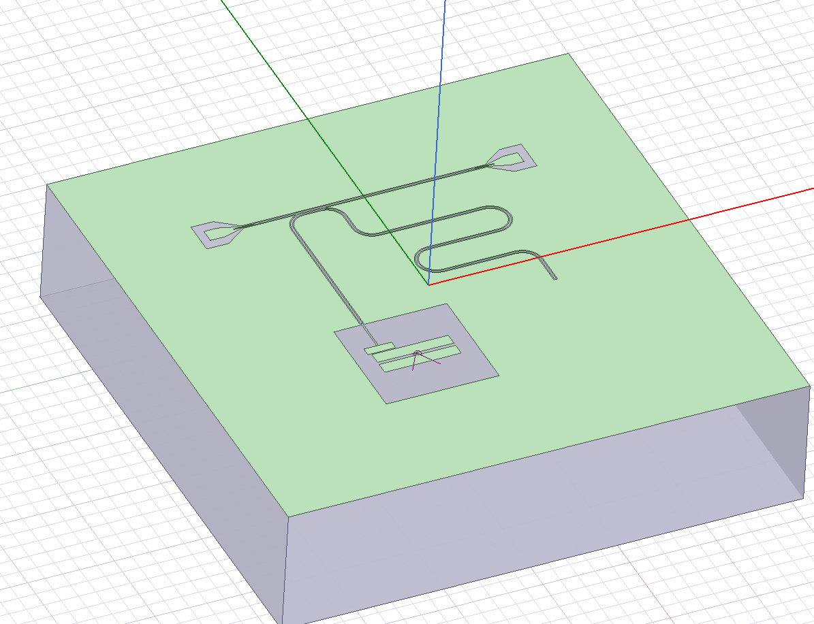
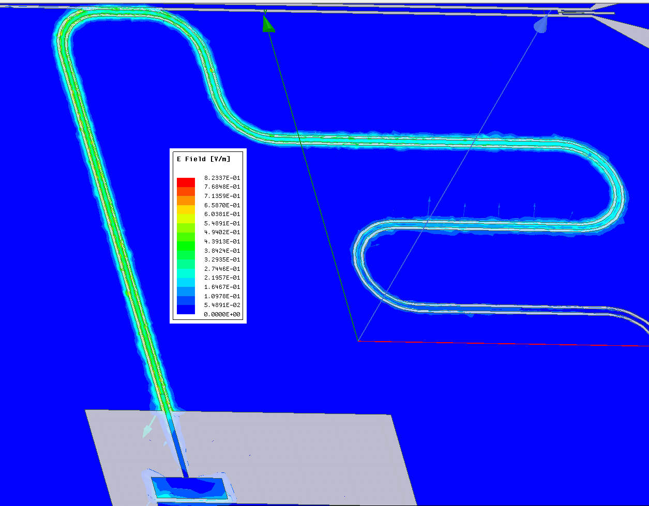
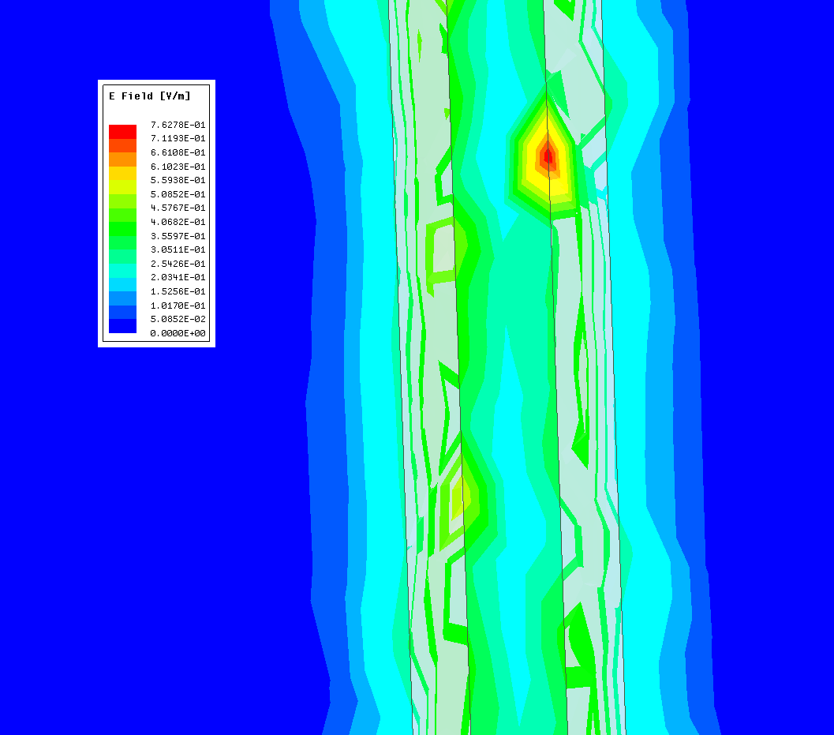
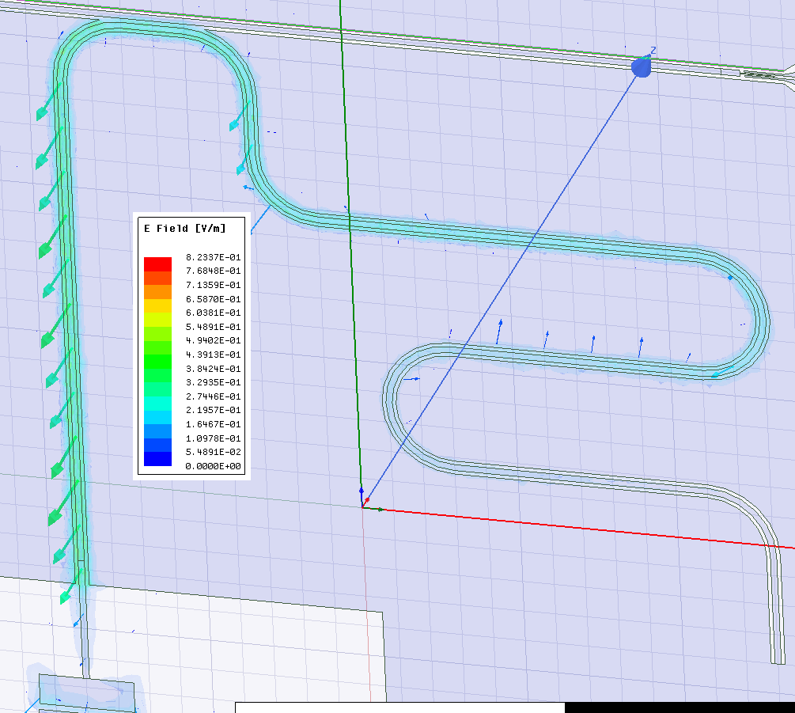
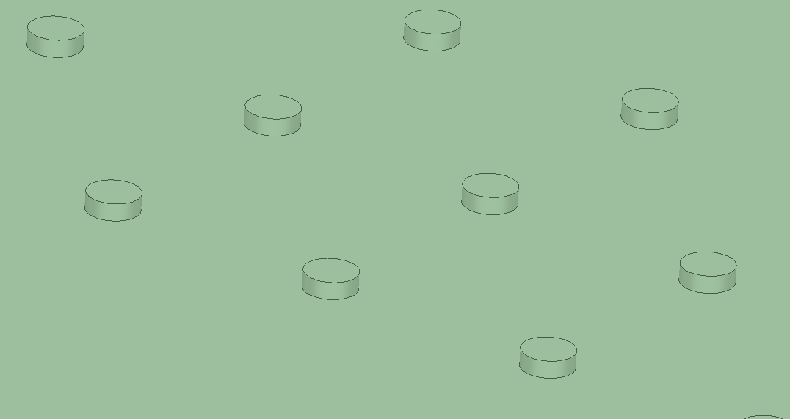
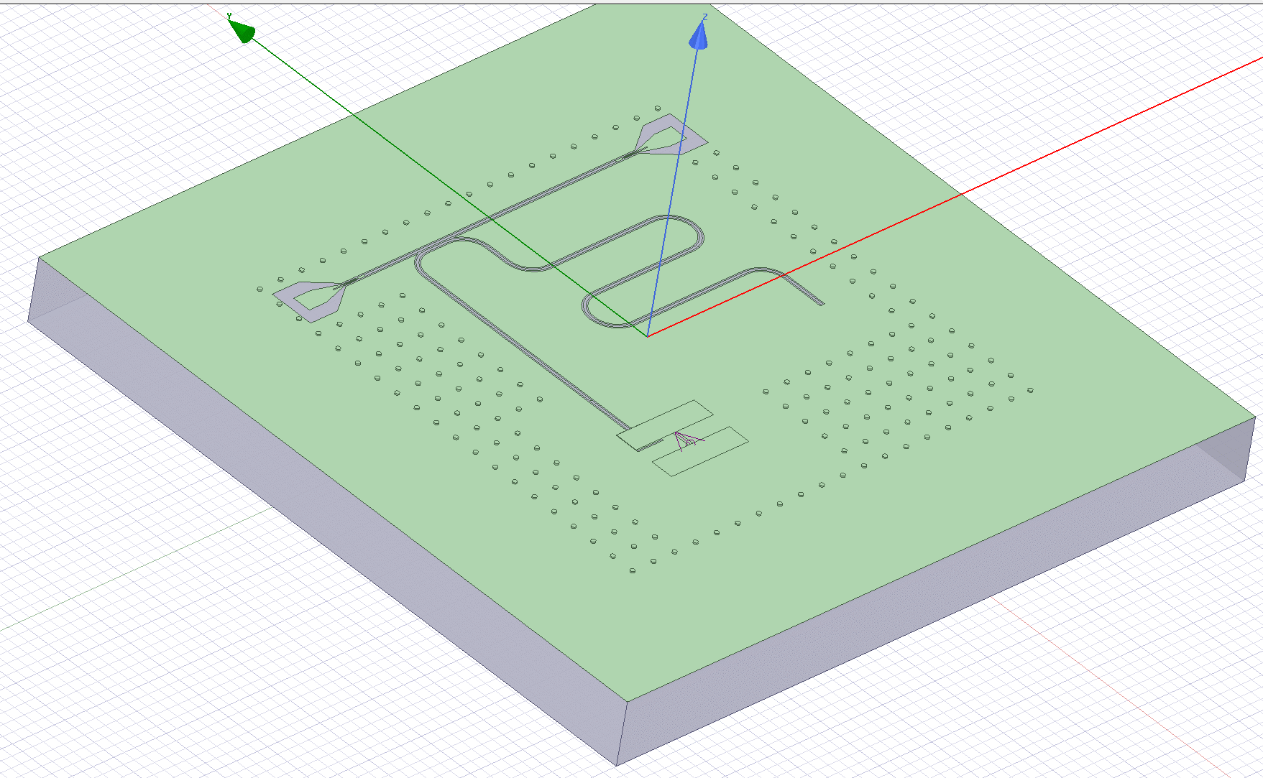
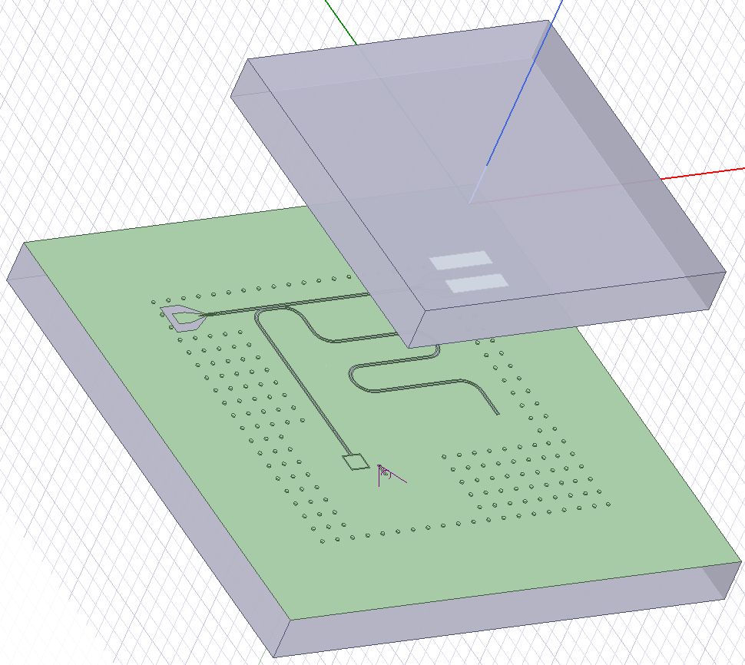
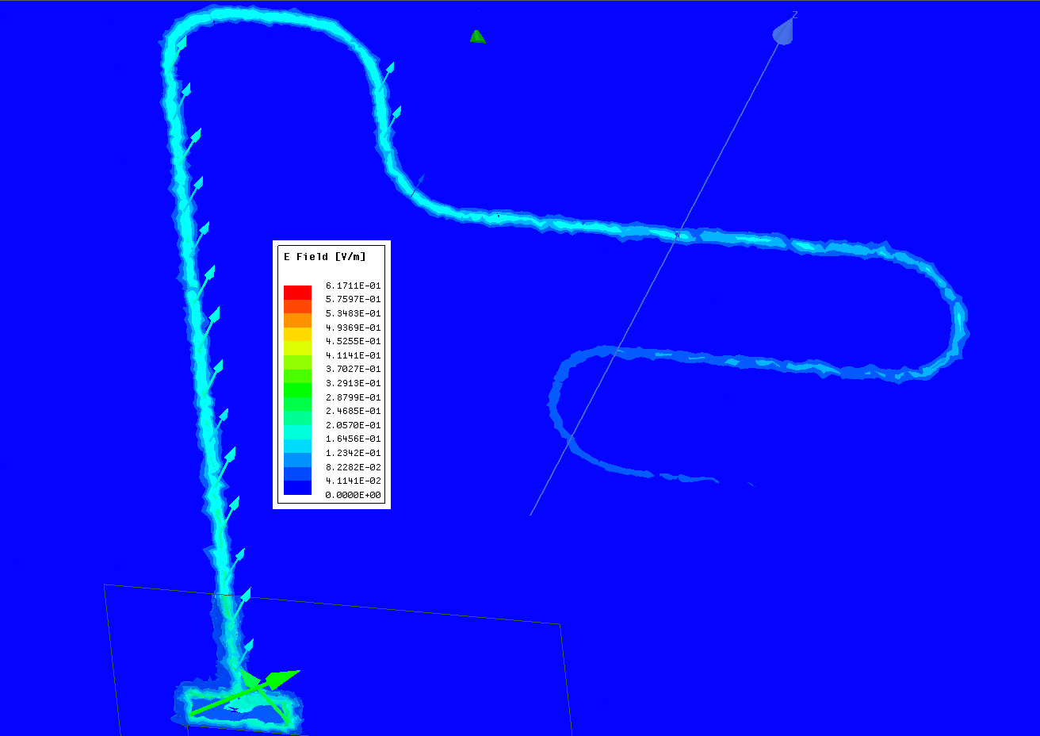
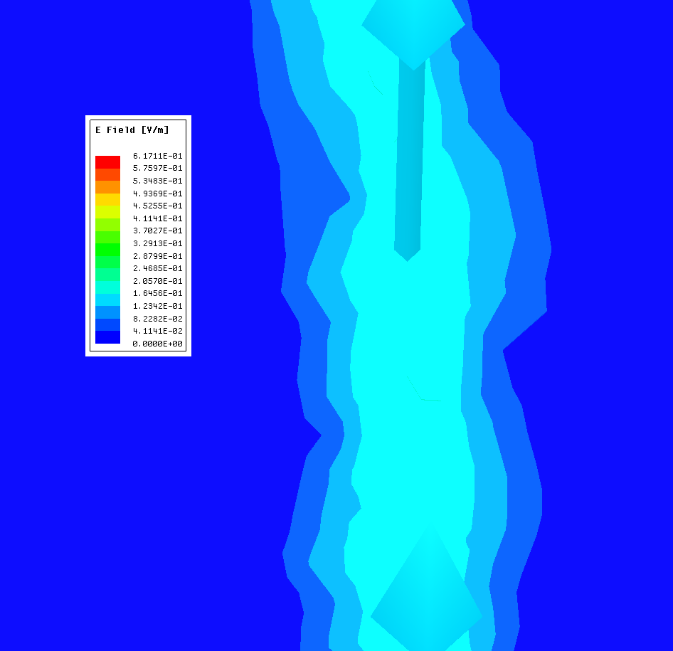
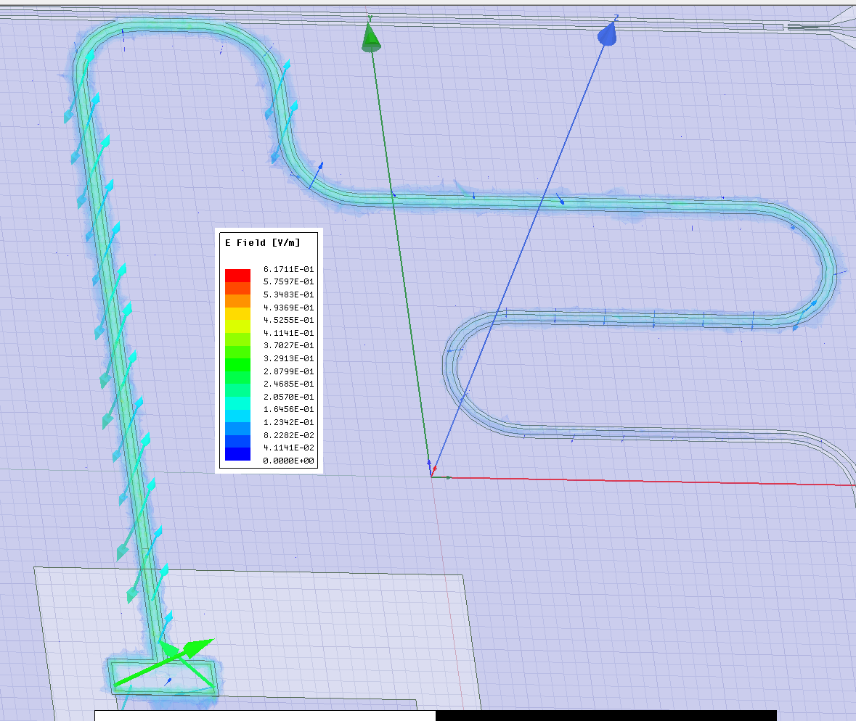
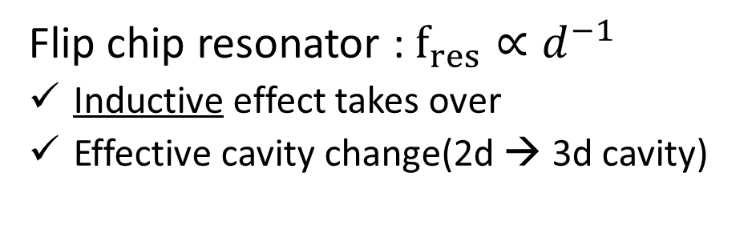
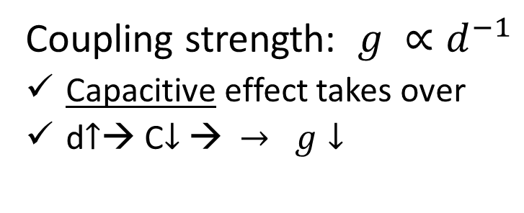
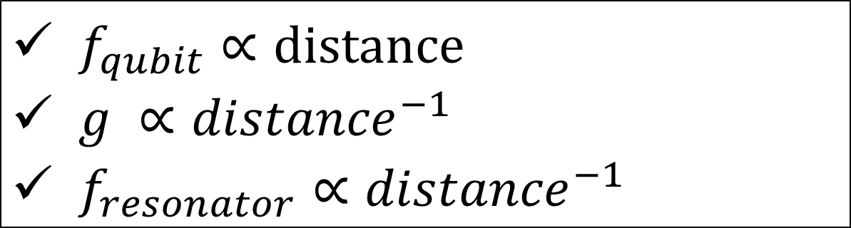
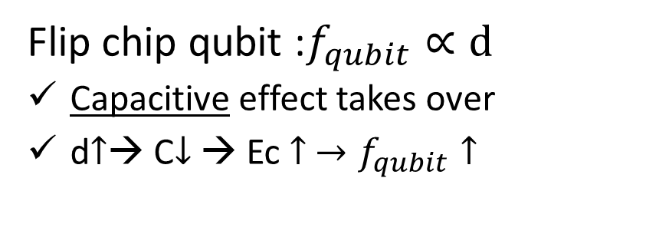
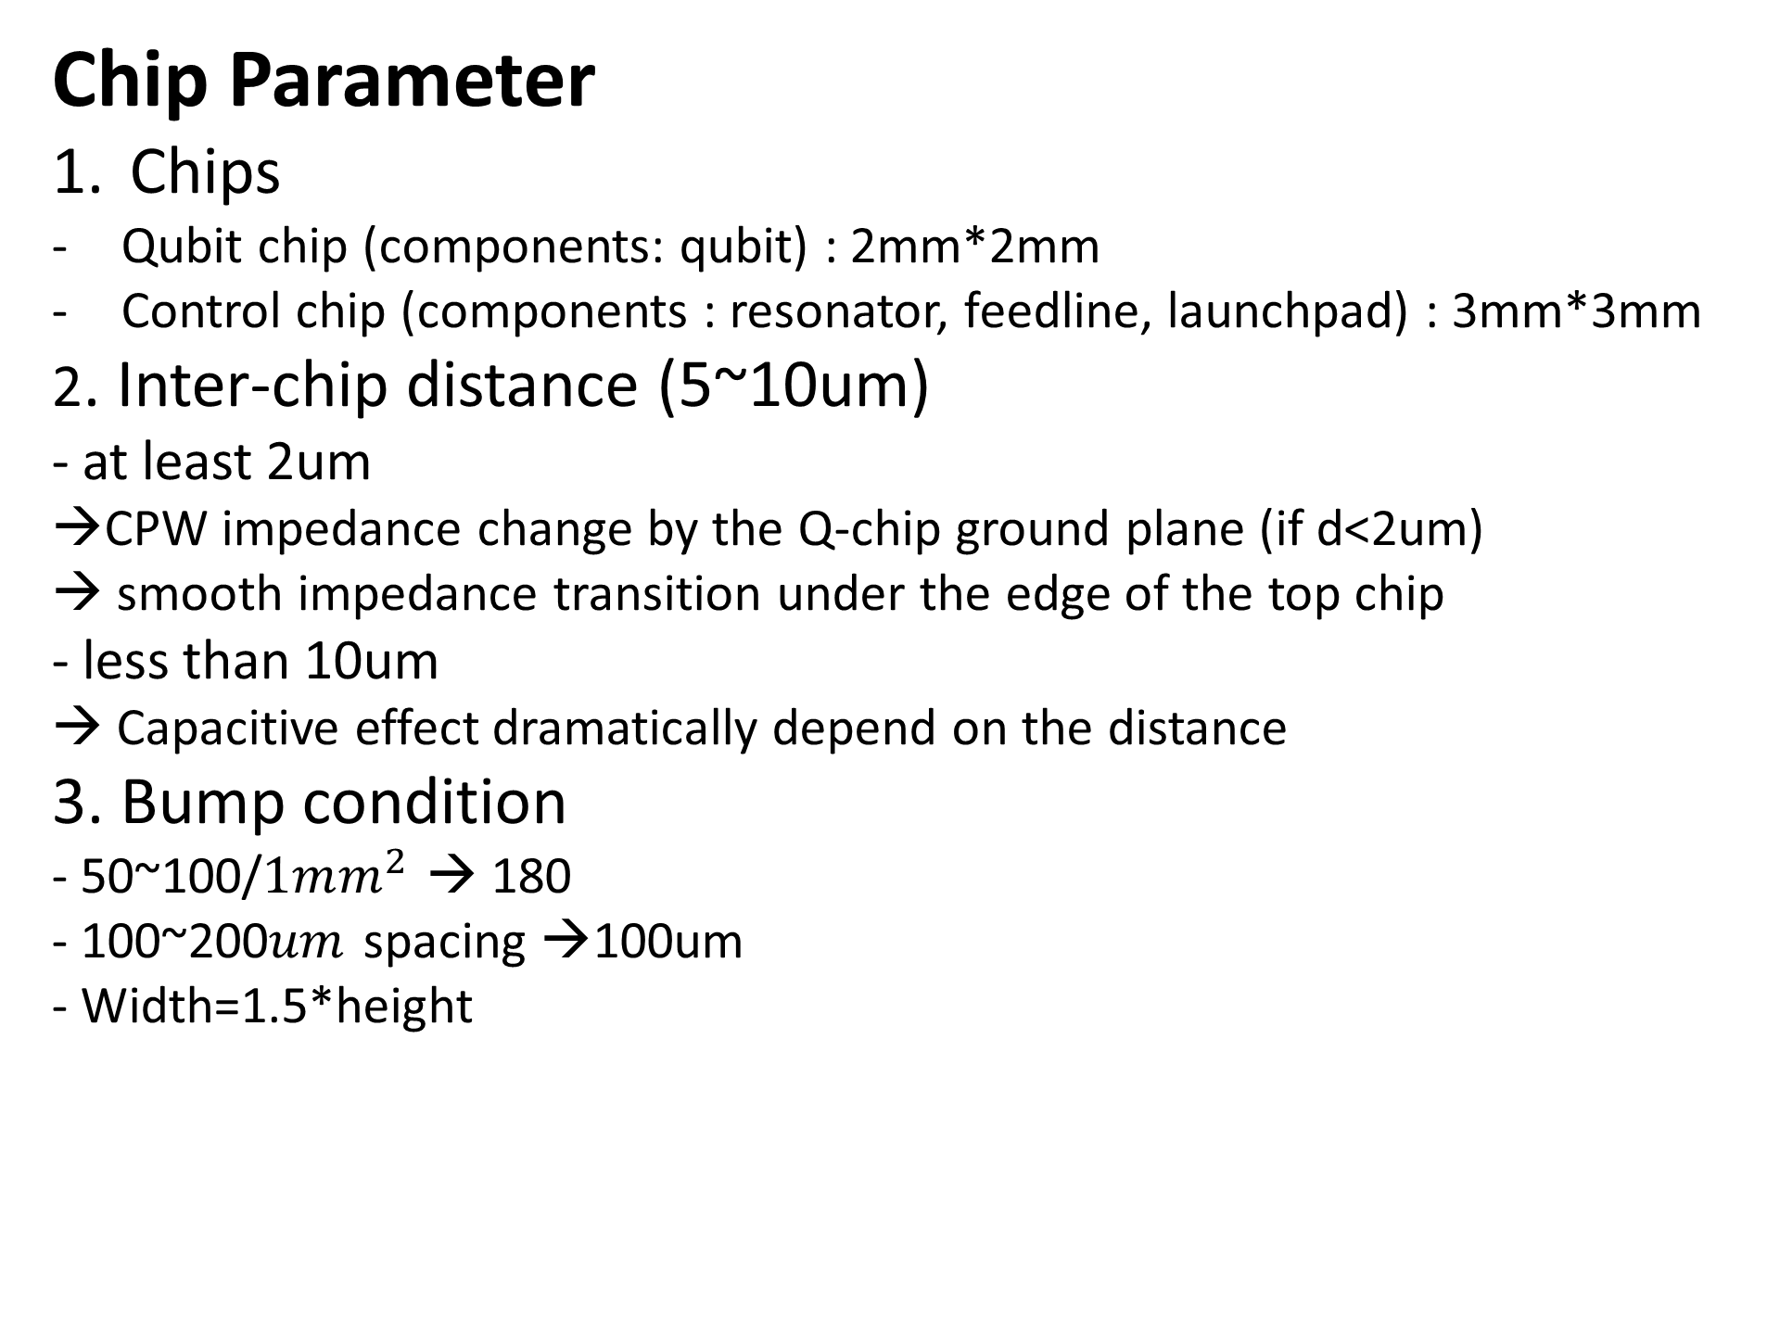
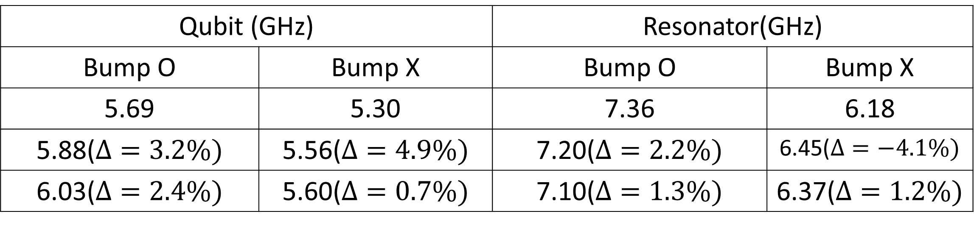
SSimulation of a flip-chip architecture
of superconducting quantum processor
Jeongwon Kim¹, Hwan-Seop Yeo¹, Seungwook Woo¹, Youngdu Kim¹, Beomgyu Choi¹, and Yonuk Chong^{1,*}
¹SKKU Advanced Institute of Nanotechnology and Department of Nano Engineering, Suwon, 16419, Republic of Korea ^{E-mail : bicycle315@skku.edu}
Introduction
Circuit QED – Resonator, Transmon, coupling strength
Planar chip, Problem
What & Why Flip-Chip
Transmon : Non-linear inductor (Josephson Junction)+ big shunt Capacitor → anharmonic quantum oscillator
Resonator : Linear inductor + capacitor → harmonic quantum oscillator
Coupling strength : determined by capacitive coupling between Transmon and Resonator
Every component on same plane
Superconducting qubit system is getting bigger and more complex
☹ When the chip becomes complex with more components → difficult wiring, qubit decoherence
Bottom, Top chip can contain any component
- Various chip size
- Inductive, Capacitive, Galvanic coupling
- Indium bump bonding/ PR Adhesion
☺ Distribute components into different layers
☺ Independent chip fabrication → high coherence qubit layer + dense wiring layer
C. R. Conner et al. . 2021.
Google 9qubit
Siddiqi, 8qubit
SKKU, 20qubit
Sandoko Kosen et al 2021.
D. I. Schuster et at.. 2019.
Simulation
Result
Chip Parameter
Chips
Qubit chip (components: qubit) : 2mm*2mm
Control chip (components : resonator, feedline, launchpad) : 3mm*3mm
2. Inter-chip distance (5~10um) - at least 2um
→CPW impedance change by the Q-chip ground plane (if d<2um) → smooth impedance transition under the edge of the top chip
- less than 10um
→ Capacitive effect dramatically depend on the distance
3. Bump condition
- 50~100/$1mm^{2}$ → 180
- 100~200$um$ spacing →100um
- Width=1.5*height
Simulation Tool
Targeting planar chip parameters in flip-chip
 | Qubit Frequency(GHz) | Resonator frequency(GHz) | Coupling strength (MHz)
Planar | 6.01 | 7.00 | 111
7um Flipchip-planar design | 5.09 | 7.33 | 39
7um Flipchip- Modified design | 5.88 | 7.20 | 115
Design modification to target the parameters
Resonator length
Coupler area
Transmon area
Couper, Transmon coupling area
Qiskit-Metal
Targeting within
Qubit:2.1%, Resonator : 2.7% g: 3.4%
Ansys HFSS,Q3D
Distance dependence of parameters
Distance dependence of parameters
Distance | Qubit (GHz) | Resonator (GHz) | Coupling g (MHz)
5um | 5.42 | 7.58 | 153
6um | 5.69 | 7.36 | 133
7um | 5.88 | 7.20 | 115
8um | 6.03 | 7.10 | 99
9um | 6.12 | 7.01 | 95
$f_{qubit}∝distance$
$g ∝{distance}^{−1}$
$f_{resonator}∝{distance}^{−1}$
Flip chip qubit :$f_{qubit}∝d$
Capacitive effect takes over
d$↑$→ C$↓$ → Ec $↑ →f_{qubit}↑$
Coupling strength: $g ∝d^{−1}$
Capacitive effect takes over
d$↑$→ C$↓$ → $→ g↓$
Flip chip resonator : $f_{res}∝d^{−1}$
Inductive effect takes over
Effective cavity change(2d → 3d cavity)
Qchip ground
Qchip ground
Qchip ground
Qchip ground
Qchip ground
Qchip ground
Qchip ground
Qchip ground
Qchip ground
qubit
qubit
qubit
qubit
qubit
qubit
CPW
CPW
CPW
Planar
2D
Resonator
Bump effect
Qubit (GHz) |  | Resonator(GHz)
Bump O | Bump X | Bump O | Bump X
5.69 | 5.30 | 7.36 | 6.18
5.88($Δ=3.2\%)$ | 5.56($Δ=4.9\%)$ | 7.20($Δ=2.2\%)$ | 6.45($Δ=−4.1\%)$
6.03($Δ=2.4\%)$ | 5.60($Δ=0.7\%)$ | 7.10($Δ=1.3\%)$ | 6.37($Δ=1.2\%)$
CPW
Flipchip
3D
Cavity
Qubit chip
Qchip ground
Conclusion & Future plan
CPW
Conclusion1 : Established simulation tools for flip chip architecture
Conclusion 2 : Can target the planar chip’s parameters in flip chip architecture
Plan1 : Simulate bigger scale flip chip including qubit couplers
Plan2 : Study and optimize the bump condition
Control chip

